Slide 1
Chapter Two: Software Processes

Slide 2
Topics covered
Software process models
Process activities
Coping with change
The Rational Unified Process
  An example of a modern software process.
Patrick Ndungu These slides are designed to accompany Software Engineering: Ian Somerville /Software Engineering: A Practitioner’s Approach, 7/e

Slide 3
The software process
A structured set of activities required to develop a
software system.
Many different software processes but all involve:
  Specification – defining what the system should do;
  Design and implementation – defining the organization of the system and implementing the system;
  Validation – checking that it does what the customer wants;
  Evolution – changing the system in response to changing customer needs.
A software process model is an abstract representation of a process. It presents a description of a process from some particular perspective.
Patrick Ndungu These slides are designed to accompany Software Engineering: Ian Somerville /Software Engineering: A Practitioner’s Approach, 7/e
Notes:
Patrick Ndungu These slides are designed to accompany Software Engineering: Ian Somerville /Software Engineering: A Practitioner’s Approach, 7/e

Slide 4
Software process descriptions
Software processes refers to:
  activities in these processes such as specifying a data model, designing a user interface, etc. and the ordering of these activities.
Process descriptions may also include:
  Products, which are the outcomes of a process activity;
  Roles, which reflect the responsibilities of the people involved in the process;
  Pre- and post-conditions, which are statements that are true before and after a process activity has been enacted or a product produced.
Patrick Ndungu These slides are designed to accompany Software Engineering: Ian Somerville /Software Engineering: A Practitioner’s Approach, 7/e

Slide 5
Plan-driven and agile processes
Plan-driven processes
  where all of the process activities are planned in advance and progress is measured against this plan.
In agile processes,
  planning is incremental and it is easier to change the process to reflect changing customer requirements.
In practice, most practical processes include elements of both plan-driven and agile approaches.
There are no right or wrong software processes.
Patrick Ndungu These slides are designed to accompany Software Engineering: Ian Somerville /Software Engineering: A Practitioner’s Approach, 7/e

Slide 6
Software process models
The waterfall model
  Plan-driven model. Separate and distinct phases of specification and development.
Incremental development
  Specification, development and validation are interleaved. May be plan-driven or agile.
Reuse-oriented software engineering
  The system is assembled from existing components. May be plan-driven or agile.
NB
  In practice, most large systems are developed using a process that incorporates elements from all of these models.
Patrick Ndungu These slides are designed to accompany Software Engineering: Ian Somerville /Software Engineering: A Practitioner’s Approach, 7/e
Notes:
Patrick Ndungu These slides are designed to accompany Software Engineering: Ian Somerville /Software Engineering: A Practitioner’s Approach, 7/e

Slide 7
Software process models
Software Development models:
  V-model:
  Waterfall model
  Incremental model
  RAD model
  Agile model
  Iterative model
  Spiral model
  Prototype model
Patrick Ndungu These slides are designed to accompany Software Engineering: Ian Somerville /Software Engineering: A Practitioner’s Approach, 7/e
Notes:
Patrick Ndungu These slides are designed to accompany Software Engineering: Ian Somerville /Software Engineering: A Practitioner’s Approach, 7/e

Slide 8
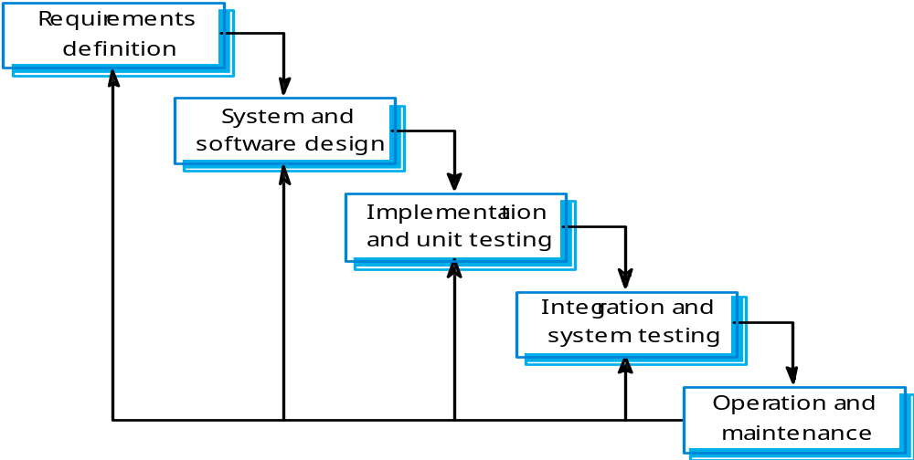
1. Waterfall model
Patrick Ndungu These slides are designed to accompany Software Engineering: Ian Somerville /Software Engineering: A Practitioner’s Approach, 7/e
Notes:
Patrick Ndungu These slides are designed to accompany Software Engineering: Ian Somerville /Software Engineering: A Practitioner’s Approach, 7/e

Slide 9
Waterfall model phases
waterfall model:
  There are separate identified phases. These are:
    the Requirements analysis and definition
    System and software design
    Implementation and unit testing
    Integration and system testing
    Operation and maintenance
main drawback of the waterfall model
  is the difficulty of accommodating change after the process is underway.
    In principle, a phase has to be complete before moving onto the next phase.
Patrick Ndungu These slides are designed to accompany Software Engineering: Ian Somerville /Software Engineering: A Practitioner’s Approach, 7/e

Slide 10
Waterfall model problems
Inflexible partitioning of the project into distinct stages makes it difficult to respond to changing customer requirements.
  Therefore,
    this model is only appropriate when the requirements are well-understood and changes will be fairly limited during the design process.
    Few business systems have stable requirements.
The waterfall model is mostly used for large systems engineering projects where a system is developed at several sites.
  In those circumstances, the plan-driven nature of the waterfall model helps coordinate the work.
Patrick Ndungu These slides are designed to accompany Software Engineering: Ian Somerville /Software Engineering: A Practitioner’s Approach, 7/e

Slide 11
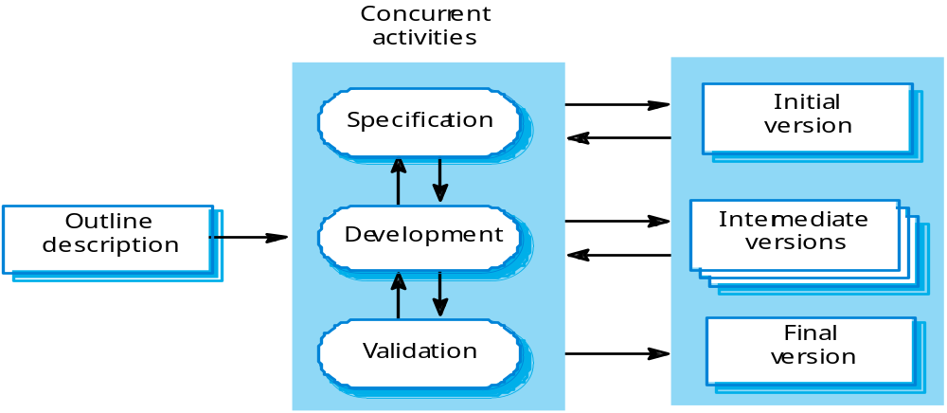
2 Evolutionary development
Patrick Ndungu These slides are designed to accompany Software Engineering: Ian Somerville /Software Engineering: A Practitioner’s Approach, 7/e

Slide 12
Benefits of Evolutionary development
The cost of accommodating changing customer requirements is reduced.
  The amount of analysis and documentation that has to be redone is much less than is required with the waterfall model.
It is easier to get customer feedback on the development work that has been done.
  Customers can comment on demonstrations of the software and see how much has been implemented.
More rapid delivery and deployment of useful software to the customer is possible.
  Customers are able to use and gain value from the software earlier than is possible with a waterfall process.
Patrick Ndungu These slides are designed to accompany Software Engineering: Ian Somerville /Software Engineering: A Practitioner’s Approach, 7/e

Slide 13
3. Incremental development problems
The process is not visible.
  Managers need regular deliverables to measure progress.
    If systems are developed quickly, it is not cost-effective to produce documents that reflect every version of the system.
System structure tends to degrade as new increments are added.
  Unless time and money is spent on refactoring to improve the software, regular change tends to corrupt its structure. Incorporating further software changes becomes increasingly difficult and costly.
Patrick Ndungu These slides are designed to accompany Software Engineering: Ian Somerville /Software Engineering: A Practitioner’s Approach, 7/e

Slide 14
4. Reuse-oriented software engineering
Based on systematic reuse where systems are integrated from existing components or COTS (Commercial-off-the-shelf) systems.
Process stages
  Component analysis;
  Requirements modification;
  System design with reuse;
  Development and integration.
Reuse is now the standard approach for building many types of business system
Patrick Ndungu These slides are designed to accompany Software Engineering: Ian Somerville /Software Engineering: A Practitioner’s Approach, 7/e

Slide 15
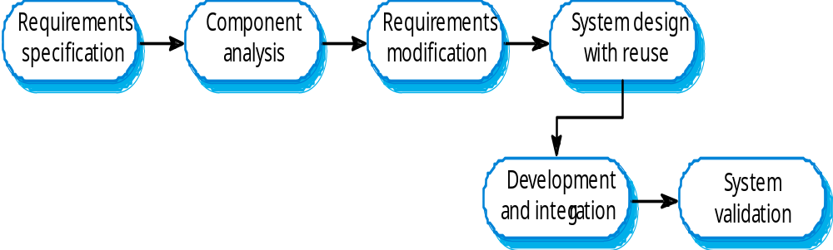
Reuse-oriented development
Patrick Ndungu These slides are designed to accompany Software Engineering: Ian Somerville /Software Engineering: A Practitioner’s Approach, 7/e

Slide 16
Types of software component
Web services that are developed according to service standards and which are available for remote invocation.
Collections of objects that are developed as a package to be integrated with a component framework such as .NET or J2EE.
Stand-alone software systems (COTS) that are configured for use in a particular environment.
Patrick Ndungu These slides are designed to accompany Software Engineering: Ian Somerville /Software Engineering: A Practitioner’s Approach, 7/e

Slide 17
Process activities
Real software processes are inter-leaved sequences of technical, collaborative and managerial activities with the overall goal of specifying, designing, implementing and testing a software system.
The four basic process activities of specification, development, validation and evolution are organized differently in different development processes. In the waterfall model, they are organized in sequence, whereas in incremental development they are inter-leaved.
Patrick Ndungu These slides are designed to accompany Software Engineering: Ian Somerville /Software Engineering: A Practitioner’s Approach, 7/e

Slide 18
Software specification
The process of establishing what services are required and the constraints on the system’s operation and development.
Requirements engineering process
  Feasibility study
    Is it technically and financially feasible to build the system?
  Requirements elicitation and analysis
    What do the system stakeholders require or expect from the system?
  Requirements specification
    Defining the requirements in detail
  Requirements validation
    Checking the validity of the requirements
Patrick Ndungu These slides are designed to accompany Software Engineering: Ian Somerville /Software Engineering: A Practitioner’s Approach, 7/e

Slide 19
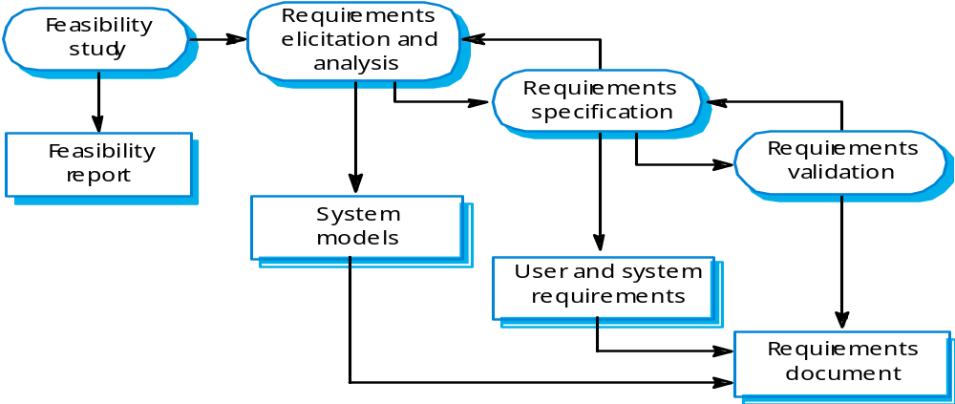
The requirements engineering process
Patrick Ndungu These slides are designed to accompany Software Engineering: Ian Somerville /Software Engineering: A Practitioner’s Approach, 7/e

Slide 20
Software design and implementation
The process of converting the system specification into an executable system.
Software design
  Design a software structure that realises the specification;
Implementation/construction
  Translate this structure into an executable program;
The activities of design and implementation are closely related and may be inter-leaved.
Patrick Ndungu These slides are designed to accompany Software Engineering: Ian Somerville /Software Engineering: A Practitioner’s Approach, 7/e

Slide 21
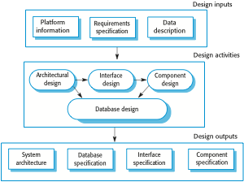
A general model of the design process
Patrick Ndungu These slides are designed to accompany Software Engineering: Ian Somerville /Software Engineering: A Practitioner’s Approach, 7/e

Slide 22
Design activities
Architectural design,
  where you identify the overall structure of the system, the principal components (sometimes called sub-systems or modules), their relationships and how they are distributed.
Interface design,
  where you define the interfaces between system components.
Component design,
  where you take each system component and design how it will operate.
Database design,
  where you design the system data structures and how these are to be represented in a database.
Patrick Ndungu These slides are designed to accompany Software Engineering: Ian Somerville /Software Engineering: A Practitioner’s Approach, 7/e

Slide 23
Software validation
Verification and validation (V & V)
  is intended to show that a system conforms to its specification and meets the requirements of the system customer.
  Involves checking and review processes and system testing.
System testing involves executing the system with test cases that are derived from the specification of the real data to be processed by the system.
Testing is the most commonly used V & V activity.
Patrick Ndungu These slides are designed to accompany Software Engineering: Ian Somerville /Software Engineering: A Practitioner’s Approach, 7/e

Slide 24

Stages of testing
Patrick Ndungu These slides are designed to accompany Software Engineering: Ian Somerville /Software Engineering: A Practitioner’s Approach, 7/e

Slide 25
Testing stages
Development or component testing
  Individual components are tested independently;
  Components may be functions or objects or coherent groupings of these entities.
System testing
  Testing of the system as a whole. Testing of emergent properties is particularly important.
Acceptance testing
  Testing with customer data to check that the system meets the customer’s needs.
Patrick Ndungu These slides are designed to accompany Software Engineering: Ian Somerville /Software Engineering: A Practitioner’s Approach, 7/e

Slide 26
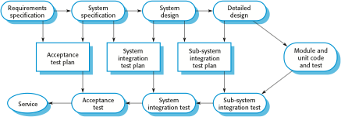
Testing phases in a plan-driven software process
Patrick Ndungu These slides are designed to accompany Software Engineering: Ian Somerville /Software Engineering: A Practitioner’s Approach, 7/e

Slide 27
Software evolution
Software is inherently flexible and can change.
  As requirements change through changing business circumstances, the software that supports the business must also evolve and change.
  Although there has been a demarcation between development and evolution (maintenance) this is increasingly irrelevant as fewer and fewer systems are completely new.
Patrick Ndungu These slides are designed to accompany Software Engineering: Ian Somerville /Software Engineering: A Practitioner’s Approach, 7/e

Slide 28

System evolution
Patrick Ndungu These slides are designed to accompany Software Engineering: Ian Somerville /Software Engineering: A Practitioner’s Approach, 7/e

Slide 29
Coping with change
Change is inevitable in all large software projects.
  Business changes lead to new and changed system requirements
  New technologies open up new possibilities for improving implementations
  Changing platforms require application changes
Change leads to rework so the costs of change include both rework (e.g. re-analysing requirements) as well as the costs of implementing new functionality
Patrick Ndungu These slides are designed to accompany Software Engineering: Ian Somerville /Software Engineering: A Practitioner’s Approach, 7/e

Slide 30
Reducing the costs of rework
Change avoidance,
  where the software process includes activities that can anticipate possible changes before significant rework is required.
  For example, a prototype system may be developed to show some key features of the system to customers.
Change tolerance,
  where the process is designed so that changes can be accommodated at relatively low cost.
    This normally involves some form of incremental development.
    Proposed changes may be implemented in increments that have not yet been developed. If this is impossible, then only a single increment (a small part of the system) may have be altered to incorporate the change.
Patrick Ndungu These slides are designed to accompany Software Engineering: Ian Somerville /Software Engineering: A Practitioner’s Approach, 7/e

Slide 31
6. Software prototyping
A prototype is an initial version of a system used to demonstrate concepts and try out design options.
A prototype can be used in:
  The requirements engineering process to help with requirements elicitation and validation;
  In design processes to explore options and develop a UI design;
  In the testing process to run back-to-back tests.
Patrick Ndungu These slides are designed to accompany Software Engineering: Ian Somerville /Software Engineering: A Practitioner’s Approach, 7/e

Slide 32
Benefits of prototyping
Improved system usability.
A closer match to users’ real needs.
Improved design quality.
Improved maintainability.
Reduced development effort.
Patrick Ndungu These slides are designed to accompany Software Engineering: Ian Somerville /Software Engineering: A Practitioner’s Approach, 7/e

Slide 33

The process of prototype development
Patrick Ndungu These slides are designed to accompany Software Engineering: Ian Somerville /Software Engineering: A Practitioner’s Approach, 7/e

Slide 34
Prototype development
May be based on rapid prototyping languages or tools
May involve leaving out functionality
  Prototype should focus on areas of the product that are not well-understood;
  Error checking and recovery may not be included in the prototype;
  Focus on functional rather than non-functional requirements such as reliability and security
Patrick Ndungu These slides are designed to accompany Software Engineering: Ian Somerville /Software Engineering: A Practitioner’s Approach, 7/e

Slide 35
Throw-away prototypes
Prototypes should be discarded after development as they are not a good basis for a production system:
  It may be impossible to tune the system to meet non-functional requirements;
  Prototypes are normally undocumented;
  The prototype structure is usually degraded through rapid change;
  The prototype probably will not meet normal organisational quality standards.
Patrick Ndungu These slides are designed to accompany Software Engineering: Ian Somerville /Software Engineering: A Practitioner’s Approach, 7/e

Slide 36
Incremental delivery
Rather than deliver the system as a single delivery, the development and delivery is broken down into increments with each increment delivering part of the required functionality.
User requirements are prioritised and the highest priority requirements are included in early increments.
Once the development of an increment is started, the requirements are frozen though requirements for later increments can continue to evolve.
Patrick Ndungu These slides are designed to accompany Software Engineering: Ian Somerville /Software Engineering: A Practitioner’s Approach, 7/e

Slide 37
Incremental development and delivery
Incremental development
  Develop the system in increments and evaluate each increment before proceeding to the development of the next increment;
  Normal approach used in agile methods;
  Evaluation done by user/customer proxy.
Incremental delivery
  Deploy an increment for use by end-users;
    More realistic evaluation about practical use of software;
    Difficult to implement for replacement systems as increments have less functionality than the system being replaced.
Patrick Ndungu These slides are designed to accompany Software Engineering: Ian Somerville /Software Engineering: A Practitioner’s Approach, 7/e

Slide 38
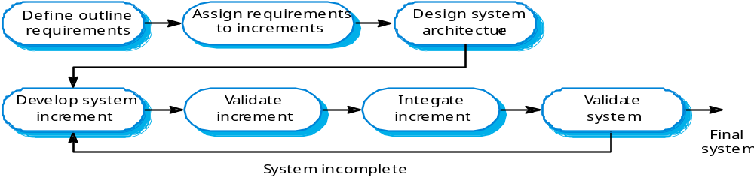
Incremental development
Patrick Ndungu These slides are designed to accompany Software Engineering: Ian Somerville /Software Engineering: A Practitioner’s Approach, 7/e

Slide 39
Incremental delivery advantages
Customer value can be delivered with each increment so system functionality is available earlier.
Early increments act as a prototype to help elicit requirements for later increments.
Lower risk of overall project failure.
The highest priority system services tend to receive the most testing.
Patrick Ndungu These slides are designed to accompany Software Engineering: Ian Somerville /Software Engineering: A Practitioner’s Approach, 7/e

Slide 40
Incremental delivery problems
Most systems require a set of basic facilities that are used by different parts of the system.
  As requirements are not defined in detail until an increment is to be implemented, it can be hard to identify common facilities that are needed by all increments.
The essence of iterative processes is that the specification is developed in conjunction with the software.
  However, this conflicts with the procurement model of many organizations, where the complete system specification is part of the system development contract.
Patrick Ndungu These slides are designed to accompany Software Engineering: Ian Somerville /Software Engineering: A Practitioner’s Approach, 7/e

Slide 41
7. Boehm’s spiral model
Process is represented as a spiral rather than as a sequence of activities with backtracking.
Each loop in the spiral represents a phase in the process.
No fixed phases such as specification or design - loops in the spiral are chosen depending on what is required.
Risks are explicitly assessed and resolved throughout the process.
Patrick Ndungu These slides are designed to accompany Software Engineering: Ian Somerville /Software Engineering: A Practitioner’s Approach, 7/e

Slide 42
Boehm’s spiral model
The spiral model combines the idea of iterative development with the systematic, controlled aspects of the waterfall model.
This Spiral model is a combination of iterative development process model and sequce emphasis on risk analysis. It allows incremental releases of the product or incremental refinement through each iteration around the spiral.
    The spiral model has four phases. A software project repeatedly passes through these phases in iterations called Spirals.
  1. Identification
    This phase starts with gathering the business requirements in the baseline spiral. In the subsequent spirals as the product matures, identification of system requirements, subsystem requirements and unit requirements are all done in this phase.
    This phase also includes understanding the system requirements by continuous communication between the customer and the system analyst. At the end of the spiral, the product is deployed in the identified market.
  2. Design
    The Design phase starts with the conceptual design in the baseline spiral and involves architectural design, logical design of modules, physical product design and the final design in the subsequent spirals.
Patrick Ndungu These slides are designed to accompany Software Engineering: Ian Somerville /Software Engineering: A Practitioner’s Approach, 7/e

Slide 43
Boehm’s spiral model
  3. Construct or Build
    The Construct phase refers to production of the actual software product at every spiral. In the baseline spiral, when the product is just thought of and the design is being developed a POC (Proof of Concept) is developed in this phase to get customer feedback.
    Then in the subsequent spirals with higher clarity on requirements and design details a working model of the software called build is produced with a version number. These builds are sent to the customer for feedback.
  4. Evaluation and Risk Analysis
    Risk Analysis includes identifying, estimating and monitoring the technical feasibility and management risks, such as schedule slippage and cost overrun. After testing the build, at the end of first iteration, the customer evaluates the software and provides feedback.
Based on the customer evaluation, the software development process enters the next iteration and subsequently follows the linear approach to implement the feedback suggested by the customer. The process of iterations along the spiral continues throughout the life of the software.
Patrick Ndungu These slides are designed to accompany Software Engineering: Ian Somerville /Software Engineering: A Practitioner’s Approach, 7/e

Slide 44
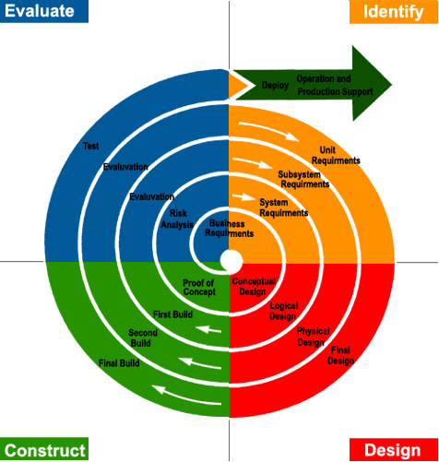
Spiral model of the software process
Patrick Ndungu These slides are designed to accompany Software Engineering: Ian Somerville /Software Engineering: A Practitioner’s Approach, 7/e
Notes:
Patrick Ndungu These slides are designed to accompany Software Engineering: Ian Somerville /Software Engineering: A Practitioner’s Approach, 7/e

Slide 45
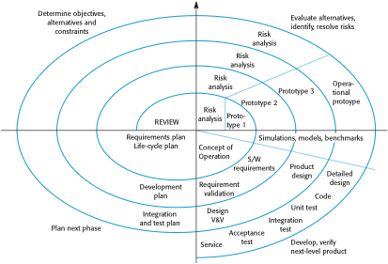
Boehm’s spiral model of the software process
Patrick Ndungu These slides are designed to accompany Software Engineering: Ian Somerville /Software Engineering: A Practitioner’s Approach, 7/e

Slide 46
Boehm’s spiral model
The steps in the spiral model can be generalized as follows:
  The new system requirements are defined in as much detail as possible. This usually involves interviewing a number of users representing all the external or internal users and other aspects of the existing system.
  A preliminary design is created for the new system.
  A first prototype of the new system is constructed from the preliminary design. This is usually a scaled-down system, and represents an approximation of the characteristics of the final product.
  A second prototype is evolved by a fourfold procedure:
    evaluating the first prototype in terms of its strengths, weaknesses, and risks;
    defining the requirements of the second prototype;
    planning and designing the second prototype;
    constructing and testing the second prototype.
Patrick Ndungu These slides are designed to accompany Software Engineering: Ian Somerville /Software Engineering: A Practitioner’s Approach, 7/e

Slide 47
Boehm’s spiral model Cont…..
  At the customer's option, the entire project can be aborted if the risk is deemed too great. Risk factors might involve development cost overruns, operating-cost miscalculation, or any other factor that could, in the customer's judgment, result in a less-than-satisfactory final product.
  The existing prototype is evaluated in the same manner as was the previous prototype, and, if necessary, another prototype is developed from it according to the fourfold procedure outlined above.
  The final system is constructed, based on the refined prototype.
  The preceding steps are iterated until the customer is satisfied that the refined prototype represents the final product desired.
  The final system is thoroughly evaluated and tested. Routine maintenance is carried out on a continuing basis to prevent large-scale failures and to minimize downtime.
Patrick Ndungu These slides are designed to accompany Software Engineering: Ian Somerville /Software Engineering: A Practitioner’s Approach, 7/e

Slide 48
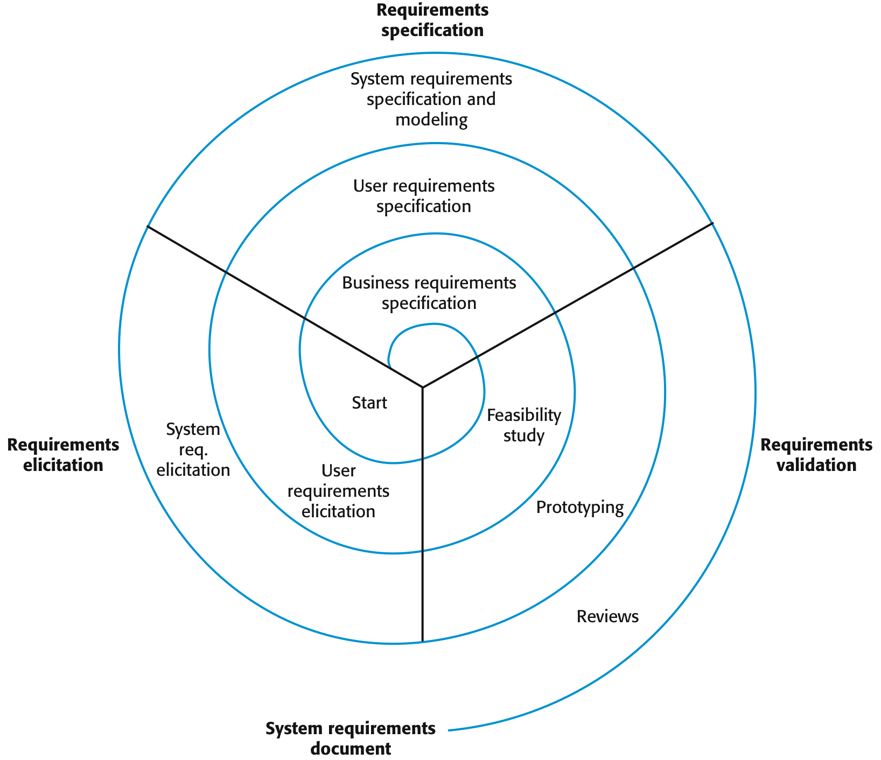
A spiral view of the requirements engineering process
Patrick Ndungu These slides are designed to accompany Software Engineering: Ian Somerville /Software Engineering: A Practitioner’s Approach, 7/e

Slide 49
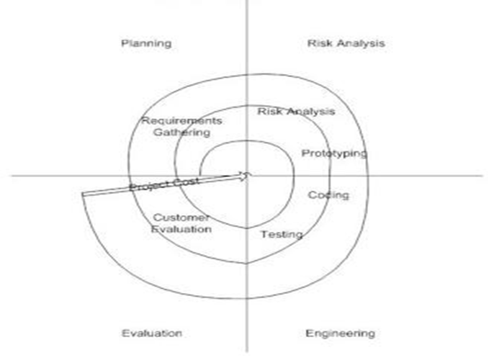
Boehm’s spiral model of the software process
Patrick Ndungu These slides are designed to accompany Software Engineering: Ian Somerville /Software Engineering: A Practitioner’s Approach, 7/e

Slide 50
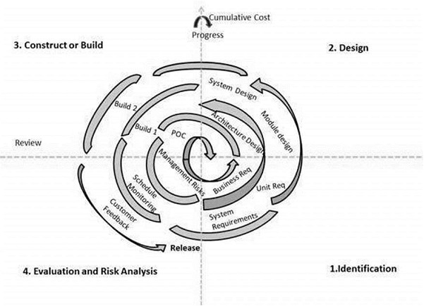
Spiral model of the software process
Patrick Ndungu These slides are designed to accompany Software Engineering: Ian Somerville /Software Engineering: A Practitioner’s Approach, 7/e
Notes:
Patrick Ndungu These slides are designed to accompany Software Engineering: Ian Somerville /Software Engineering: A Practitioner’s Approach, 7/e

Slide 51
Spiral model sectors
Objective setting
  Specific objectives for the phase are identified.
Risk assessment and reduction
  Risks are assessed and activities put in place to reduce the key risks.
Development and validation
  A development model for the system is chosen which can be any of the generic models.
Planning
  The project is reviewed and the next phase of the spiral is planned.
Patrick Ndungu These slides are designed to accompany Software Engineering: Ian Somerville /Software Engineering: A Practitioner’s Approach, 7/e

Slide 52
Spiral model usage
Spiral model has been very influential in helping people think about iteration in software processes and introducing the risk-driven approach to development.
In practice, however, the model is rarely used as published for practical software development.
Patrick Ndungu These slides are designed to accompany Software Engineering: Ian Somerville /Software Engineering: A Practitioner’s Approach, 7/e
Notes:
Patrick Ndungu These slides are designed to accompany Software Engineering: Ian Somerville /Software Engineering: A Practitioner’s Approach, 7/e

Slide 53
Agile methods
Dissatisfaction with the overheads involved in software design methods of the 1980s and 1990s led to the creation of agile methods. These methods:
  Focus on the code rather than the design
  Are based on an iterative approach to software development
  Are intended to deliver working software quickly and evolve this quickly to meet changing requirements.
The aim of agile methods is to reduce overheads in the software process (e.g. by limiting documentation) and to be able to respond quickly to changing requirements without excessive rework.
Patrick Ndungu These slides are designed to accompany Software Engineering: Ian Somerville /Software Engineering: A Practitioner’s Approach, 7/e

Slide 54
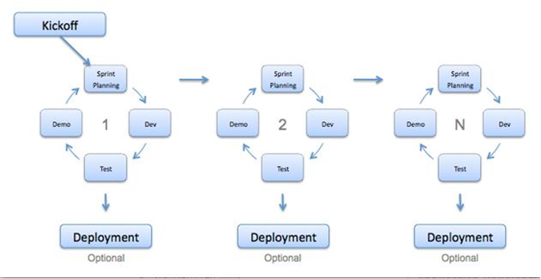
Agile model
Agile development model is also a type of Incremental model.
  Software is developed in incremental, rapid cycles.
    This results in small incremental releases with each release building on previous functionality.
      Each release is thoroughly tested to ensure software quality is maintained. It is used for time critical applications. Extreme Programming (XP) is currently one of the most well known agile development life cycle model.
Patrick Ndungu These slides are designed to accompany Software Engineering: Ian Somerville /Software Engineering: A Practitioner’s Approach, 7/e

Slide 55
Agile model Cont….
Advantages of Agile model:
  Customer satisfaction by rapid, continuous delivery of useful software.
  People and interactions are emphasized rather than process and tools. Customers, developers and testers constantly interact with each other.
  Working software is delivered frequently (weeks rather than months).
  Face-to-face conversation is the best form of communication.
  Close, daily cooperation between business people and developers.
  Continuous attention to technical excellence and good design.
  Regular adaptation to changing circumstances.
  Even late changes in requirements are welcomed
Disadvantages of Agile model:
  In case of some software deliverables, especially the large ones, it is difficult to assess the effort required at the beginning of the software development life cycle.
  There is lack of emphasis on necessary designing and documentation.
  The project can easily get taken off track if the customer representative is not clear what final outcome that they want.
  Only senior programmers are capable of taking the kind of decisions required during the development process. Hence it has no place for newbie programmers, unless combined with experienced resources.
Patrick Ndungu These slides are designed to accompany Software Engineering: Ian Somerville /Software Engineering: A Practitioner’s Approach, 7/e

Slide 56
Agile model Cont…..
When to use Agile model:
  When new changes are needed to be implemented. The freedom agile gives to change is very important. New changes can be implemented at very little cost because of the frequency of new increments that are produced.
  To implement a new feature the developers need to lose only the work of a few days, or even only hours, to roll back and implement it.
  Unlike the waterfall model in agile model very limited planning is required to get started with the project. Agile assumes that the end users’ needs are ever changing in a dynamic business and IT world. Changes can be discussed and features can be newly effected or removed based on feedback. This effectively gives the customer the finished system they want or need.
  Both system developers and stakeholders alike, find they also get more freedom of time and options than if the software was developed in a more rigid sequential way. Having options gives them the ability to leave important decisions until more or better data or even entire hosting programs are available; meaning the project can continue to move forward without fear of reaching a sudden standstill.
Patrick Ndungu These slides are designed to accompany Software Engineering: Ian Somerville /Software Engineering: A Practitioner’s Approach, 7/e

Slide 57
The principles of agile methods
Principle | Description
Customer involvement | Customers should be closely involved throughout the development process. Their role is provide and prioritize new system requirements and to evaluate the iterations of the system.
Incremental delivery | The software is developed in increments with the customer specifying the requirements to be included in each increment.
People not process | The skills of the development team should be recognized and exploited. Team members should be left to develop their own ways of working without prescriptive processes.
Embrace change | Expect the system requirements to change and so design the system to accommodate these changes.
Maintain simplicity | Focus on simplicity in both the software being developed and in the development process. Wherever possible, actively work to eliminate complexity from the system.
Patrick Ndungu These slides are designed to accompany Software Engineering: Ian Somerville /Software Engineering: A Practitioner’s Approach, 7/e

Slide 58
Agile method applicability
Product development where a software company is developing a small or medium-sized product for sale.
Custom system development within an organization, where there is a clear commitment from the customer to become involved in the development process and where there are not a lot of external rules and regulations that affect the software.
Because of their focus on small, tightly-integrated teams, there are problems in scaling agile methods to large systems.
Patrick Ndungu These slides are designed to accompany Software Engineering: Ian Somerville /Software Engineering: A Practitioner’s Approach, 7/e

Slide 59
Problems with agile methods
It can be difficult to keep the interest of customers who are involved in the process.
Team members may be unsuited to the intense involvement that characterises agile methods.
Prioritising changes can be difficult where there are multiple stakeholders.
Maintaining simplicity requires extra work.
Contracts may be a problem as with other approaches to iterative development.
Patrick Ndungu These slides are designed to accompany Software Engineering: Ian Somerville /Software Engineering: A Practitioner’s Approach, 7/e

Slide 60
Agile methods and software maintenance
Most organizations spend more on maintaining existing software than they do on new software development. So, if agile methods are to be successful, they have to support maintenance as well as original development.
Two key issues:
  Are systems that are developed using an agile approach maintainable, given the emphasis in the development process of minimizing formal documentation?
  Can agile methods be used effectively for evolving a system in response to customer change requests?
Problems may arise if original development team cannot be maintained.
Patrick Ndungu These slides are designed to accompany Software Engineering: Ian Somerville /Software Engineering: A Practitioner’s Approach, 7/e

Slide 61
Plan-driven and agile development
Plan-driven development
  A plan-driven approach to software engineering is based around separate development stages with the outputs to be produced at each of these stages planned in advance.
  Not necessarily waterfall model – plan-driven, incremental development is possible
  Iteration occurs within activities.
Agile development
  Specification, design, implementation and testing are inter-leaved and the outputs from the development process are decided through a process of negotiation during the software development process.
Patrick Ndungu These slides are designed to accompany Software Engineering: Ian Somerville /Software Engineering: A Practitioner’s Approach, 7/e

Slide 62
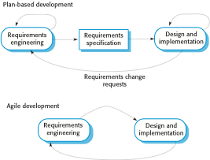
Plan-driven and agile specification
Patrick Ndungu These slides are designed to accompany Software Engineering: Ian Somerville /Software Engineering: A Practitioner’s Approach, 7/e

Slide 63
Technical, human, organizational issues
Most projects include elements of plan-driven and agile processes. Deciding on the balance depends on:
  Is it important to have a very detailed specification and design before moving to implementation? If so, you probably need to use a plan-driven approach.
  Is an incremental delivery strategy, where you deliver the software to customers and get rapid feedback from them, realistic? If so, consider using agile methods.
  How large is the system that is being developed? Agile methods are most effective when the system can be developed with a small co-located team who can communicate informally. This may not be possible for large systems that require larger development teams so a plan-driven approach may have to be used.
Patrick Ndungu These slides are designed to accompany Software Engineering: Ian Somerville /Software Engineering: A Practitioner’s Approach, 7/e

Slide 64
Technical, human, organizational issues
  What type of system is being developed?
    Plan-driven approaches may be required for systems that require a lot of analysis before implementation (e.g. real-time system with complex timing requirements).
  What is the expected system lifetime?
    Long-lifetime systems may require more design documentation to communicate the original intentions of the system developers to the support team.
  What technologies are available to support system development?
    Agile methods rely on good tools to keep track of an evolving design
  How is the development team organized?
    If the development team is distributed or if part of the development is being outsourced, then you may need to develop design documents to communicate across the development teams.
Patrick Ndungu These slides are designed to accompany Software Engineering: Ian Somerville /Software Engineering: A Practitioner’s Approach, 7/e

Slide 65
Technical, human, organizational issues
  Are there cultural or organizational issues that may affect the system development?
    Traditional engineering organizations have a culture of plan-based development, as this is the norm in engineering.
  How good are the designers and programmers in the development team?
    It is sometimes argued that agile methods require higher skill levels than plan-based approaches in which programmers simply translate a detailed design into code
  Is the system subject to external regulation?
    If a system has to be approved by an external regulator (e.g. the FAA approve software that is critical to the operation of an aircraft) then you will probably be required to produce detailed documentation as part of the system safety case.
Patrick Ndungu These slides are designed to accompany Software Engineering: Ian Somerville /Software Engineering: A Practitioner’s Approach, 7/e

Slide 66
Extreme programming
Perhaps the best-known and most widely used agile method.
Extreme Programming (XP) takes an ‘extreme’ approach to iterative development.
  New versions may be built several times per day;
  Increments are delivered to customers every 2 weeks;
  All tests must be run for every build and the build is only accepted if tests run successfully.
Patrick Ndungu These slides are designed to accompany Software Engineering: Ian Somerville /Software Engineering: A Practitioner’s Approach, 7/e

Slide 67
XP and agile principles
Incremental development is supported through small, frequent system releases.
Customer involvement means full-time customer engagement with the team.
People not process through pair programming, collective ownership and a process that avoids long working hours.
Change supported through regular system releases.
Maintaining simplicity through constant refactoring of code.
Patrick Ndungu These slides are designed to accompany Software Engineering: Ian Somerville /Software Engineering: A Practitioner’s Approach, 7/e

Slide 68
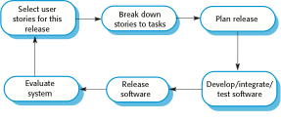
The extreme programming release cycle
Patrick Ndungu These slides are designed to accompany Software Engineering: Ian Somerville /Software Engineering: A Practitioner’s Approach, 7/e

Slide 69
Extreme programming practices (a)
Principle or practice | Description
Incremental planning | Requirements are recorded on story cards and the stories to be included in a release are determined by the time available and their relative priority. The developers break these stories into development ‘Tasks’.
Small releases | The minimal useful set of functionality that provides business value is developed first. Releases of the system are frequent and incrementally add functionality to the first release.
Simple design | Enough design is carried out to meet the current requirements and no more.
Test-first development | An automated unit test framework is used to write tests for a new piece of functionality before that functionality itself is implemented.
Refactoring | All developers are expected to refactor the code continuously as soon as possible code improvements are found. This keeps the code simple and maintainable.
Patrick Ndungu These slides are designed to accompany Software Engineering: Ian Somerville /Software Engineering: A Practitioner’s Approach, 7/e

Slide 70
Extreme programming practices
Pair programming | Developers work in pairs, checking each other’s work and providing the support to always do a good job.
Collective ownership | The pairs of developers work on all areas of the system, so that no islands of expertise develop and all the developers take responsibility for all of the code. Anyone can change anything.
Continuous integration | As soon as the work on a task is complete, it is integrated into the whole system. After any such integration, all the unit tests in the system must pass.
Sustainable pace | Large amounts of overtime are not considered acceptable as the net effect is often to reduce code quality and medium term productivity
On-site customer | A representative of the end-user of the system (the customer) should be available full time for the use of the XP team. In an extreme programming process, the customer is a member of the development team and is responsible for bringing system requirements to the team for implementation.
Patrick Ndungu These slides are designed to accompany Software Engineering: Ian Somerville /Software Engineering: A Practitioner’s Approach, 7/e

Slide 71
Requirements scenarios
In XP, a customer or user is part of the XP team and is responsible for making decisions on requirements.
User requirements are expressed as scenarios or user stories.
These are written on cards and the development team break them down into implementation tasks. These tasks are the basis of schedule and cost estimates.
The customer chooses the stories for inclusion in the next release based on their priorities and the schedule estimates.
Patrick Ndungu These slides are designed to accompany Software Engineering: Ian Somerville /Software Engineering: A Practitioner’s Approach, 7/e

Slide 72
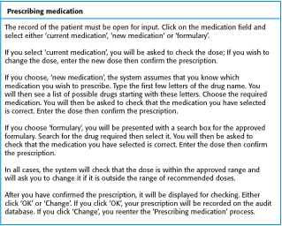
A ‘prescribing medication’ story
Patrick Ndungu These slides are designed to accompany Software Engineering: Ian Somerville /Software Engineering: A Practitioner’s Approach, 7/e

Slide 73
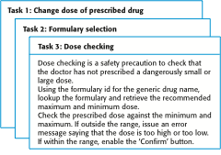
Examples of task cards for prescribing medication
Patrick Ndungu These slides are designed to accompany Software Engineering: Ian Somerville /Software Engineering: A Practitioner’s Approach, 7/e

Slide 74
XP and change
Conventional wisdom in software engineering is to design for change. It is worth spending time and effort anticipating changes as this reduces costs later in the life cycle.
XP, however, maintains that this is not worthwhile as changes cannot be reliably anticipated.
Rather, it proposes constant code improvement (refactoring) to make changes easier when they have to be implemented.
Patrick Ndungu These slides are designed to accompany Software Engineering: Ian Somerville /Software Engineering: A Practitioner’s Approach, 7/e

Slide 75
Refactoring
Programming team look for possible software improvements and make these improvements even where there is no immediate need for them.
This improves the understandability of the software and so reduces the need for documentation.
Changes are easier to make because the code is well-structured and clear.
However, some changes requires architecture refactoring and this is much more expensive.
Patrick Ndungu These slides are designed to accompany Software Engineering: Ian Somerville /Software Engineering: A Practitioner’s Approach, 7/e

Slide 76
Examples of refactoring
Re-organization of a class hierarchy to remove duplicate code.
Tidying up and renaming attributes and methods to make them easier to understand.
The replacement of inline code with calls to methods that have been included in a program library.
Patrick Ndungu These slides are designed to accompany Software Engineering: Ian Somerville /Software Engineering: A Practitioner’s Approach, 7/e

Slide 77
The Rational Unified Process
A modern generic process derived from the work on the UML and associated process.
Brings together aspects of the 3 generic process models discussed previously.
Normally described from 3 perspectives
  A dynamic perspective that shows phases over time;
  A static perspective that shows process activities;
  A practive perspective that suggests good practice.
Patrick Ndungu These slides are designed to accompany Software Engineering: Ian Somerville /Software Engineering: A Practitioner’s Approach, 7/e

Slide 78

Phases in the Rational Unified Process
Patrick Ndungu These slides are designed to accompany Software Engineering: Ian Somerville /Software Engineering: A Practitioner’s Approach, 7/e

Slide 79
RUP phases
Inception
  Establish the business case for the system.
Elaboration
  Develop an understanding of the problem domain and the system architecture.
Construction
  System design, programming and testing.
Transition
  Deploy the system in its operating environment.
Patrick Ndungu These slides are designed to accompany Software Engineering: Ian Somerville /Software Engineering: A Practitioner’s Approach, 7/e

Slide 80
RUP iteration
In-phase iteration
  Each phase is iterative with results developed incrementally.
Cross-phase iteration
  As shown by the loop in the RUP model, the whole set of phases may be enacted incrementally.
Patrick Ndungu These slides are designed to accompany Software Engineering: Ian Somerville /Software Engineering: A Practitioner’s Approach, 7/e

Slide 81
The Rational Unified Process cont…..
The Unified Process
  Whereas the traditional waterfall model in Structured development methodology is a one-dimensional methodology,
  Unified Process is a two dimensional methodology consisting of workflows and phases
  The system development phases of the waterfall model correspond to the workflows of the unified Process as shown below.
Patrick Ndungu These slides are designed to accompany Software Engineering: Ian Somerville /Software Engineering: A Practitioner’s Approach, 7/e

Slide 82
The Rational Unified Process cont…..
The Unified Process
  Whereas the traditional waterfall model in Structured development methodology is a one-dimensional methodology,
  Unified Process is a two dimensional methodology consisting of workflows and phases
  The system development phases of the waterfall model correspond to the workflows of the unified Process as shown below.
    Each phase must go through the five workflows iteratively.
    A Workflow is presented in a technical context while a phase is presented in a business context.
Patrick Ndungu These slides are designed to accompany Software Engineering: Ian Somerville /Software Engineering: A Practitioner’s Approach, 7/e

Slide 83
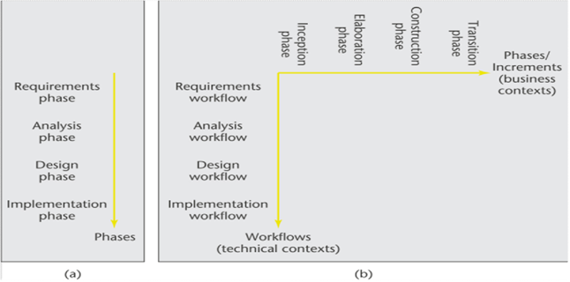
The Rational Unified Process cont…..
The Unified Process
Patrick Ndungu These slides are designed to accompany Software Engineering: Ian Somerville /Software Engineering: A Practitioner’s Approach, 7/e
Notes:
Patrick Ndungu These slides are designed to accompany Software Engineering: Ian Somerville /Software Engineering: A Practitioner’s Approach, 7/e

Slide 84
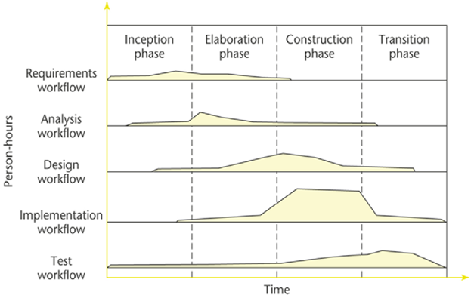
The Rational Unified Process cont…..
Phases of the Unified Process
Patrick Ndungu These slides are designed to accompany Software Engineering: Ian Somerville /Software Engineering: A Practitioner’s Approach, 7/e
Notes:
Patrick Ndungu These slides are designed to accompany Software Engineering: Ian Somerville /Software Engineering: A Practitioner’s Approach, 7/e

Slide 85
The Rational Unified Process cont…..
Unified Process Workflows
  Workflows of the Unified Process are as follows:
    Requirements workflow
    Analysis workflow
    Design workflow
    Implementation workflow
    Test workflow
  In addition to the five core workflows, the Unified Process includes other workflows
    Management
    Planning
Patrick Ndungu These slides are designed to accompany Software Engineering: Ian Somerville /Software Engineering: A Practitioner’s Approach, 7/e
Notes:
Patrick Ndungu These slides are designed to accompany Software Engineering: Ian Somerville /Software Engineering: A Practitioner’s Approach, 7/e

Slide 86
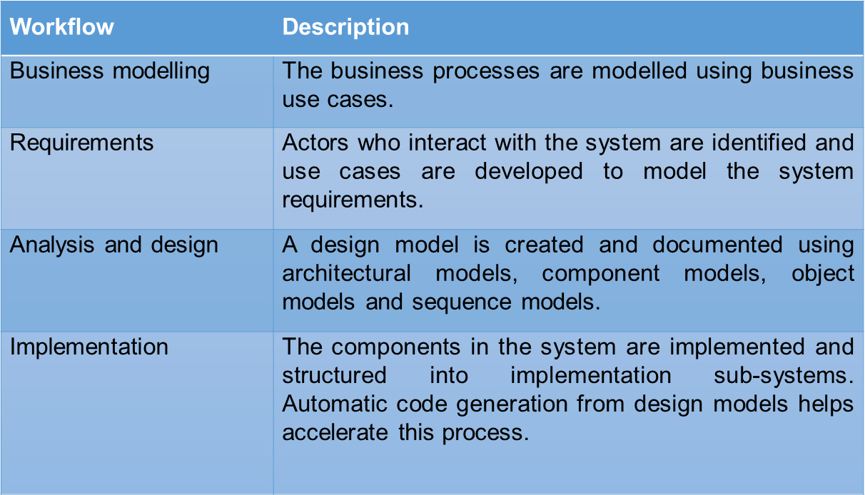
Static workflows in the Rational Unified Process
Patrick Ndungu These slides are designed to accompany Software Engineering: Ian Somerville /Software Engineering: A Practitioner’s Approach, 7/e

Slide 87
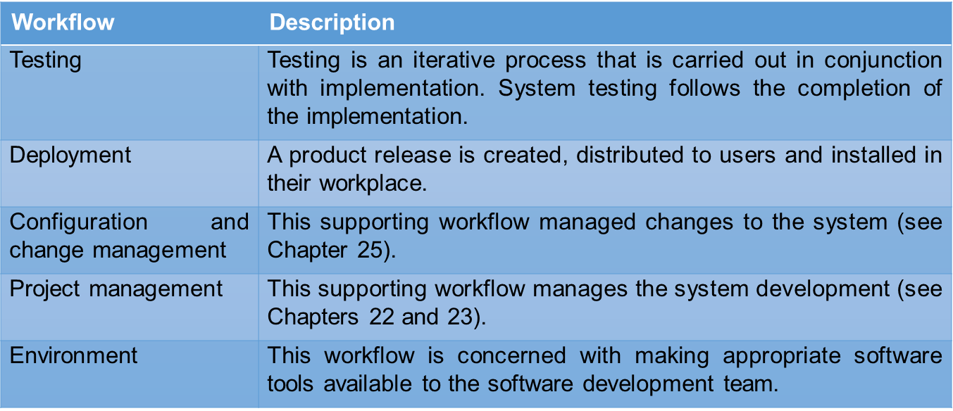
Static workflows in the Rational Unified Process
Patrick Ndungu These slides are designed to accompany Software Engineering: Ian Somerville /Software Engineering: A Practitioner’s Approach, 7/e

Slide 88
RUP good practice
Why A Two-Dimensional Model?
  The development task has to be divided into increments (phases). Within each increment, iteration is performed until the task is complete
  In an ideal world, each phase would be completed before the next phase was started. At the beginning of the process, there is not enough information about the information system to carry out the requirements workflow.
  An information system has to be broken into subsystems. Even subsystems can be too large at times. Modules may be all that can be handled until a fuller understanding of all the parts of the information system as a whole has been obtained.
Patrick Ndungu These slides are designed to accompany Software Engineering: Ian Somerville /Software Engineering: A Practitioner’s Approach, 7/e

Slide 89
RUP good practice
The Unified Process is the best solution found to date for treating a large problem as a set of smaller, largely independent subproblems that provide a framework for incrementation and iteration.
The Unified Process also handles the inevitable changes well: The moving target problem and The inevitable mistakes
The Iterative, Incremental Framework is a logical extension to the spiral model, but is more formal and rigorous. We will be following an Iterative, Incremental Framework through the rest of this course.
Patrick Ndungu These slides are designed to accompany Software Engineering: Ian Somerville /Software Engineering: A Practitioner’s Approach, 7/e

Slide 90
RUP good practice
Develop software iteratively
  Plan increments based on customer priorities and deliver highest priority increments first.
Manage requirements
  Explicitly document customer requirements and keep track of changes to these requirements.
Use component-based architectures
  Organize the system architecture as a set of reusable components.
Patrick Ndungu These slides are designed to accompany Software Engineering: Ian Somerville /Software Engineering: A Practitioner’s Approach, 7/e

Slide 91
RUP good practice
Visually model software
  Use graphical UML models to present static and dynamic views of the software.
Verify software quality
  Ensure that the software meet’s organizational quality standards.
Control changes to software
  Manage software changes using a change management system and configuration management tools.
Patrick Ndungu These slides are designed to accompany Software Engineering: Ian Somerville /Software Engineering: A Practitioner’s Approach, 7/e

Slide 92
The END
      Q&A
      THANKS
Patrick Ndungu These slides are designed to accompany Software Engineering: Ian Somerville /Software Engineering: A Practitioner’s Approach, 7/e
Notes:
Patrick Ndungu These slides are designed to accompany Software Engineering: Ian Somerville /Software Engineering: A Practitioner’s Approach, 7/e

